Slide 1
Russians Fleeing Putin’s country:
Daily Stressors, Traumatic Experience, Anxiety, Depression, Post Traumatic Stress Disorder
Maria McCready
Dimitri Bolt

Slide 2

Method
The target participant population was adult Russian emigrants who left Russia after February 24th, 2022 (n = 67).
Our focus was on Russian emigrants in Armenia and Georgia.
There was a similar number of female (45%) and male (49%) participants; 3% of participants were non-binary. Most participants were 25-44 years old (62%); ethnically Russian (70%); married (43%); had at least five years of college (35%); and had an average income (46%).

Slide 3

Measures
Daily Stressors Assessment (adapted from The Barcelona Immigration Stress Scale);
Harvard Trauma Questionnaire (HTQ);
Hopkins Symptom Checklist (HSCL-25);
These assessments were conducted in Russian and administered online;
All measures were obtained in Russian directly from the publisher.

Slide 4
Results: Premigration Traumatic Events
The number of pre-immigration traumatic events was assessed using the first part of the Harvard Trauma Questionnaire (HTQ-5).
In total, 66 participants responded to the questions of Part I of HTQ-5, with 59 (89%) endorsing at least one traumatic event. On average, they endorsed 3.1 (SD = 2.7) traumatic events. The most prevalent traumatic events are summarized in Table 1.
Trauma events | % | n
Separation from family members | 59% | 39
Brainwashing | 42% | 28
Lack of shelter | 41% | 27
Betrayal of family member, or friend | 36% | 24
Ill health without access to medical care | 21% | 14
Event endorsement was not mutually exclusive

Slide 5
Results: Symptoms of Post Traumatic Stress Disorder (PTSD)
Trauma symptoms | % | n
Feeling detached or withdrawn from people | 74% | 48
Difficulty concentrating | 82% | 53
Trouble sleeping | 75% | 49
Less interest in daily activities | 74% | 48
Feeling as if you don’t have a future | 77% | 50
Event endorsement was not mutually exclusive
Symptoms of PTSD were assessed by Part II of HTQ-5.
Out of the 65 participants who responded to this part of the questionnaire, all 65 (100%) had at least the lowest level of one trauma symptom on the ordinal scale.
Table summarizes the most prevalent traumatic symptoms experienced at any level (at least at a minimum).
Eleven participants (17%) qualified for the diagnosis of PTSD, with a confidence interval of 8% to 25%

Slide 6

Results: Symptoms of Anxiety and Depression
Sixty-four participants completed Part I of the Hopkins Symptom Checklist-25 (HSCL-25) to assess anxiety symptoms. Among them, 60 (94%) exhibited at least the lowest level of one symptom of anxiety. In accordance with HSCL-25 guidelines, we determined that 44% of participants could be considered symptomatic for anxiety, with a confidence interval (CI) of 32% to 56%.
Sixty-three participants filled out Part II of the HSCL-25 to evaluate depression symptoms. All 63 participants (100%) reported experiencing at least the lowest level of one symptom of depression. Following HSCL-25 guidelines, we found that 67% of participants could be considered symptomatic for depression, with a confidence interval (CI) of 55% to 78%.

Slide 7

Results
Six potential cause-effect relationships:
  Traumatic experience-anxiety;
  Traumatic experience-depression;
  Traumatic experience-PTSD;
  Daily stressors-anxiety;
  Daily stressors-depression;
  Daily stressors-PTSD.

Slide 8
Daily stressors-Depression
Regression analysis showed that there is a significant correlation between daily stressors assessment and depression (R²=0.77). It means that the daily stressors explain 77% of depression variance.
Effect | Estimate | SE | 95% CI |  | p-value
 |  |  | LL | UL
Fixed effects
Intercept | 3.36 | 0.48 | 2.37 | 4.36 | 0.00
I do not trust the people of this country | -0.17 | 0.09 | -0.36 | 0.01 | 0.07
Society constantly reminds you that you are an immigrant | 0.25 | 0.13 | -0.01 | 0.51 | 0.06
I have too many responsibilities | -0.34 | 0.13 | -0.61 | -0.07 | 0.01
I feel like I have abandoned my family | -0.36 | 0.17 | -0.72 | 0.00 | 0.05

Slide 9
Quantitative spin-off results of the immigrant study
Maria McCready, M.S., mmccread@unm.edu
Dimitri Bolt, M.S., DimitriBolt75@unm.edu.
Notes:
Hi, I am Dimitri. I hold a Master's degree in Mathematics and Sociology. I enjoy working with numbers and uncovering hidden insights in data.
Please excuse any language errors, as I primarily communicate in Python and mathematical language, with English being less common for me. If my communication is unclear, feel free to direct your questions to Maria.

Slide 10
Content:
Data description
Interesting spin-off results
List of variables
  Anxiety,
  PTSD,
  Depression,
  Daily stressors,
  Traumas.
Example of variable distribution.
Data visualization.
Pairwise correlation of columns
Stepwise Regression Implementation
Notes:
Hello, let me start.
The main goal of this presentation is to introduce you to some interesting spin-off results. The primary challenge for me was extracting interesting findings from a very limited dataset. It is mixed-methods research with only 68 observations, which is insufficient for quantitative analysis. Nevertheless, let's proceed.
First, I will introduce you to the initial data, which is displayed on the left part of this slide.
Then, I will demonstrate how to extract additional results from the data, which is shown on the right part of this slide.
I will not delve into the principal results of the study. If you have any questions about the design or principal findings, please direct them to Maria.

Slide 11
Variables
Daily stressors
  The variable "daily stressors" consists of 31 features and 67 observations. The measurement was made by bipolar 4-Point Likert Scale.
Trauma
  The variable "trauma" has 17 binary features "Yes" ↔ "No", and 66 observations.
Anxiety
  The variable "Anxiety" is continuous and calculated according to the "Anxiety Score" formula.
Depression
  A variable "Depression" is continuous and calculated according to the "DSM IV Depression Score" formula.
PTSD
  A Variable "PTSD symptoms" is continuous and calculated according to the "DSM-5 Trauma Symptom Score" formula from the "HARVARD TRAUMA QUESTIONNAIRE" method.
Notes:
Maria collected data in the form of 5 variables.
Regarding terminology:
Where you have a question, I refer to it as a feature.
Where you have an answer, I refer to it as a value.
Where you have a patient, I refer to it as an observation.
Two variables are complex data, and three variables are continuous. If you have any questions about the data structure, I can show you the questionnaires and papers that Maria used for data collection.

Slide 12
Variable description, e.g., PTSD
Table 3 The most prevalent traumatic symptoms which were experienced at any level (at least at minim). HTQ-5 (n = 65)
Table 4 The most prevalent traumatic symptoms which were experienced at maximum level. HTQ-5 (n = 65)
Trauma symptoms | % | n
Feeling detached or withdrawn from people | 74% | 48
Difficulty concentrating | 82% | 53
Trouble sleeping | 75% | 49
Less interest in daily activities | 74% | 48
Feeling as if you don’t have a future | 77% | 50
Event endorsement was not mutually exclusive
Trauma symptoms | % | n
Difficulty concentrating | 20% | 13
Trouble sleeping | 22% | 14
Feeling irritable or having outbursts of anger | 20% | 13
Feeling as if you don’t have a future | 26% | 17
Difficulty feeling love or happiness | 20% | 13
Event endorsement was not mutually exclusive
Notes:
Any variables are described according to APA standards. It is not interesting for me because it is descriptions only, stating facts only.

Slide 13
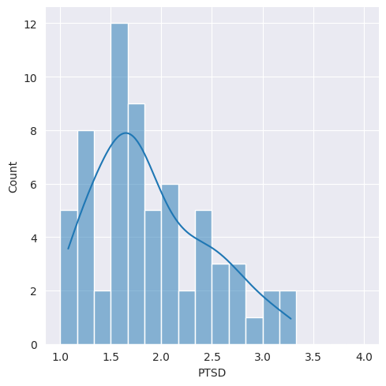
Variable visualization, e.g., PTSD
Following HTQ-5 guidelines, we calculated the percentage of participants who could be considered symptomatic for PTSD, 11 (17%) of participants qualified for the diagnosis. Using Bernoulli distribution confidence intervals (CI) were calculated. CI (of PTSD level) = (8%; 25%).
Detailed calculus is here: ConfidenceIntervals
Notes:
Any variables are visualized. For each variable, a confidence interval is calculated. For example, at least 8 percent of respondents have PTSD, and up to 25%.

Slide 14
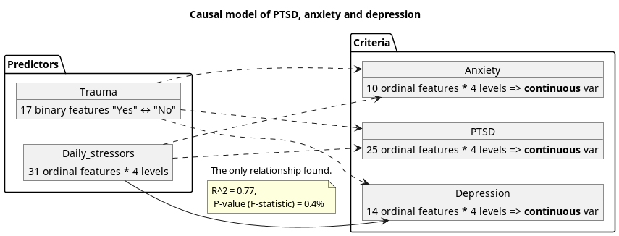
Interesting spin-off results
Notes:
Now we are ready to move on to the interesting results. As I mentioned, we have 5 variables. David recommended considering Trauma and Daily Stressors as predictors and Anxiety, PTSD, and Depression as criteria. So, David supposed that there might be 6 cause-effect dependencies. For example, Depression may depend on Daily Stressors or PTSD may depend on Trauma, and so on.

Slide 15
Depression ~ Daily stressors
Notes:
Let me start from a dependency Depression of Daily stressors.

Slide 16

Pairwise correlation of columns.
Multi-collinearity!! We can see that some features are highly correlated. It is not good. Let’s remove one of the features.
Я чувствую как будто я бросил свою семью. ≠ I feel like I have abandoned my family. Wrong translation
Notes:
If we are searching for dependencies between a criterion and predictors, we must ensure that all predictors are independent. Otherwise, our model will be incorrect.
Let's create a pairwise correlation of columns. Allow me to demonstrate the calculation process.
Take a look at the red square in the center of the picture. We can see an abnormal correlation between two features. Let's calculate the correlation. It is 83 percent. This indicates an error in the design of the study. Because I understand the language of the respondents, I can see the root of the problem: incorrect translation. The translations of those features are identical in the respondents' language.
What is the conclusion of this verification? Only pairwise correlation can reveal wrong questions that are identical for respondents.

Slide 17
Features with less than 0.08 p-value in APA format.
 | Estimate | SE | LL | UL | p
const | 3.23 | 0.36 | 2.5 | 3.96 | 0
Я не доверяю людям в этой стране. / I do not trust the people of this country. | -0.14 | 0.08 | -0.3 | 0.01 | 0.07
Я скучаю по атмосфере моего родного города (села). / I miss the atmosphere of my hometown. | -0.25 | 0.09 | -0.42 | -0.07 | 0.01
Социум постоянно напоминает мне, что я иммигрант. / Society constantly reminds you that you are an immigrant. | 0.24 | 0.09 | 0.06 | 0.41 | 0.01
У меня слишком много обязанностей. / I have too many responsibilities. | -0.38 | 0.1 | -0.58 | -0.19 | 0
Я не чувствую себя здесь принятым. / I do not feel accepted here. | -0.21 | 0.11 | -0.43 | 0.01 | 0.06
Я чувствую вину за то, что я оставил свою семью. / I feel guilty for having left my family. | -0.17 | 0.08 | -0.33 | -0.01 | 0.04
Я часто чувствую себя напряженным. / I frequently feel tense. | 0.23 | 0.11 | 0.01 | 0.46 | 0.04
Я чувствую давление от жителей этой страны принять их стиль жизни. / I feel pressured by the people of this country to adopt their lifestyle. | 0.28 | 0.12 | 0.04 | 0.52 | 0.02
Я чувствую, что я никогда не смогу вернуться на родину. / I feel like I will never be able to come back to my homeland. | -0.27 | 0.1 | -0.47 | -0.07 | 0.01
Adjusted Coefficient of determination: 0.56
Coefficient of determination: 0.68
p-value (F-statistic): 0.00001
Coefficient of determination is 0.68, it means that the model explains 68% of the variability of the response data around its mean. The probability, that all the regression coefficients are zero, equals to 0.001%, it means that the model is correct.
Notes:
Let me continue with the calculation program.
To build the model, David suggested using Stepwise Regression, which is a very good idea. With 68 observations and 31 features, we can explain any dependency without real meaning. We must reduce the number of features, extract those that explain the criterion, and remove predictors that spoil the model. Let's use Stepwise Regression for dimensionality reduction. Once again, thanks to David for the idea.
...
Now you understand the reasons for depression among immigrants.
It's truly remarkable. You only had 68 patients, yet you have extracted universal reasons for depression among immigrants.

Slide 18
Interesting, controversial and unexpected results
What we have got, and we do not have.
Notes:
Let me continue to bigger miracles. You would never guess what we found.

Slide 19
Factors that most effectively reduce depression rates in immigrants.
 | Estimate | SE | LL | UL | p
const | 3.23 | 0.36 | 2.5 | 3.96 | 0
Society constantly reminds you that you are an immigrant. | 0.24 | 0.09 | 0.06 | 0.41 | 0.01
I feel pressured by the people of this country to adopt their lifestyle. | 0.28 | 0.12 | 0.04 | 0.52 | 0.02
A modern liberal viewpoint suggests that we should respect immigrants' cultures. However, the data indicates that if immigrants feel societal pressure to assimilate and adopt the local lifestyle, it actually reduces depression rates among them.
¯\_(ツ)_/¯
Notes:
A modern liberal viewpoint suggests that we should respect immigrants' cultures. However, the data indicates that if immigrants feel societal pressure to assimilate and adopt the local lifestyle, it actually reduces depression rates among them.

Slide 20

Very interesting to explore not only what influences depression but also which features do not have an impact on it.
 | Poor | Rich
Happy | ✔ | ✔
Unhappy | ✔ | ✔
We need to examine not only the features that influence depression but also those with a large p-value, indicating they are not significant in the cause-effect model.
Least significant factors include:
Having financial problems.
Being worried about the inability to support one's family.
Notes:
Next interesting result. See the calculating program.
We need to examine not only the features that influence depression but also those with a large p-value, indicating they are not significant in the cause-effect model.
Least significant factors include:
Having financial problems.
Being worried about the inability to support one's family.

Slide 21
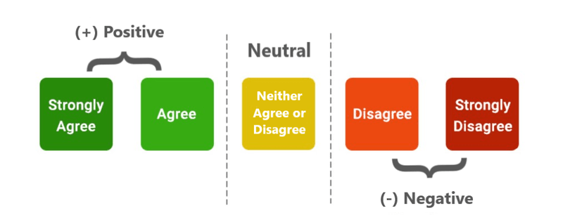
Daily stressors. Encoding.
the measurement was made by bipolar 4-Point Likert Scale.
Encoding was made according to the "The Barcelona immigration stress scale":
  0 = “Strongly agree”
  1 = “Moderately agree”
  2 = “Moderately disagree”
  3 = “Strongly disagree”.
More natural encoding:
  "Strongly agree" = 2
  "Agree" = 1
  "Neither Agree or Disagree" = 0
  "Disagree" = -1
  "Strongly Disagree" = -2
Notes:
I want to draw your attention to encoding. The conclusions I described are highly dependent on encoding.
Maria used an encoding from "The Barcelona Immigration Stress Scale," which is more natural. Each of these has advantages and disadvantages. If you are interested in this nuance, I can provide you with a few useful papers.

Slide 22
PTSD ~ Traumas (MultiRegression)

Slide 23
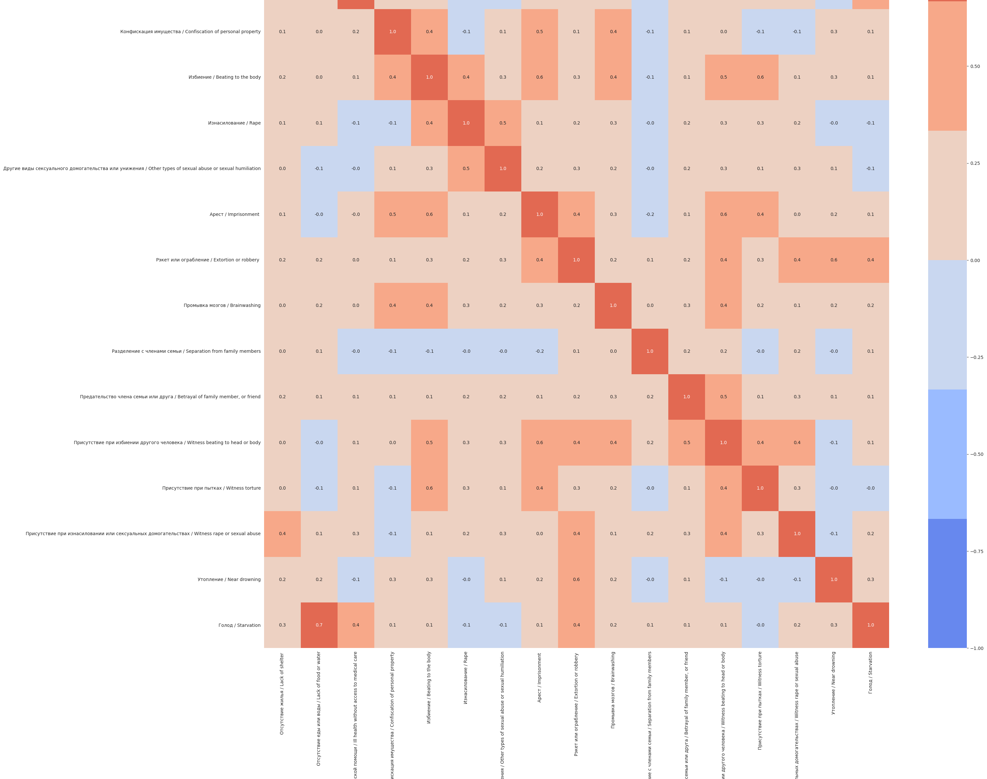
Pairwise correlation of columns.
Multi-collinearity!! We can see that some features are highly correlated. It is not good. Let’s remove one of the features.
There is collinearity between "Starvation" and "Lack of food or water," indicating that we need to eliminate one of them. Respondents seem unable to distinguish between these two concepts.
Notes:
They make the model worse. How respondents perceive the questions.

Slide 24
Table of features with less than 0.15 p-value
 | Estimate | SE | LL | UL | P-value
const | 1.74 | 0.1 | 1.53 | 1.94 | 0
Lack of shelter | 0.24 | 0.14 | -0.05 | 0.52 | 0.1
Ill health without access to medical care | 0.38 | 0.17 | 0.04 | 0.72 | 0.03
Beating to the body | 0.43 | 0.29 | -0.16 | 1.01 | 0.15
Adjusted Coefficient of determination: 0.16
Coefficient of determination: 0.25
p-value (F-statistic): 0.017

